Slide 1
12 Commandments of Instrument Care
by A. Harman

Slide 2
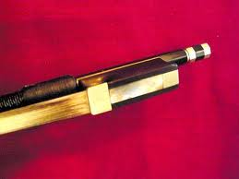
Thou Shalt Not Touch Bow Hair
Touching the bow hair makes oil and dirt from your fingers stick to the bow hair, making rosin less-likely to stay on the bow and causing the bow to make an unpleasant sound.

Slide 3
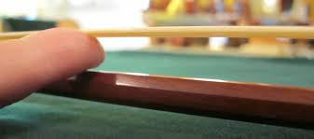
Thou Shalt Never
Over-tighten Bow Hair
A finger-width is all that is needed. Make sure the stick is still curved the right direction!

Slide 4

Thou Shalt Always Loosen
Bow Hair After Playing
Loosen the hair just until the individual bow hairs start to separate and touch the stick.

Slide 5

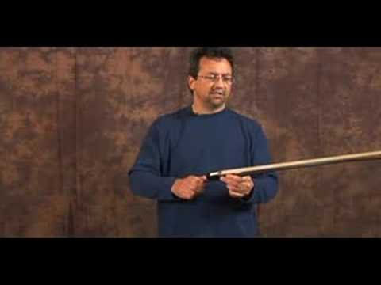
Thou Shalt Rosin your Bow
Your bow won’t work without it.

Slide 6
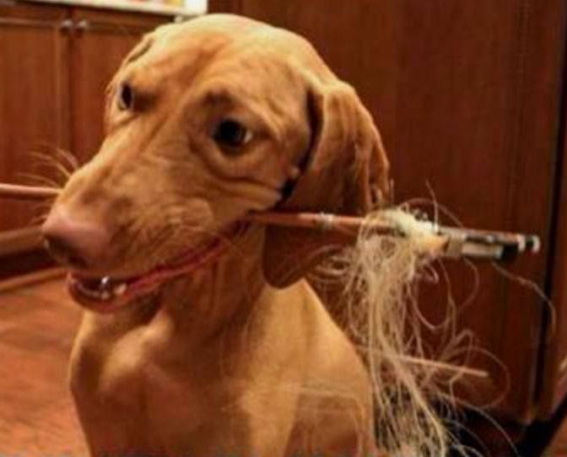
Thou Shalt Not Play Fetch with your Bow
Bows are not toys. Bad dog.

Slide 7

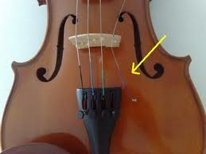
Thou Shalt Never Try
to Tune By Yourself
You will break a string. I promise. Do you know how much new strings cost? Guess.

Slide 8
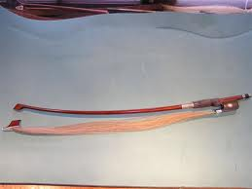
Thou Shalt Be Careful
Don’t run with your instrument
Don’t sword fight
Don’t trip over cello or bass endpins
Don’t sit on your instrument
Don’t leave instrument unattended
Don’t leave instrument on the floor

Slide 9
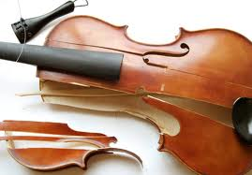
Thou Shalt Never Leave
Instrument In Car or Bus
Extreme shifts in temperature may cause your instrument to crack!

Slide 10

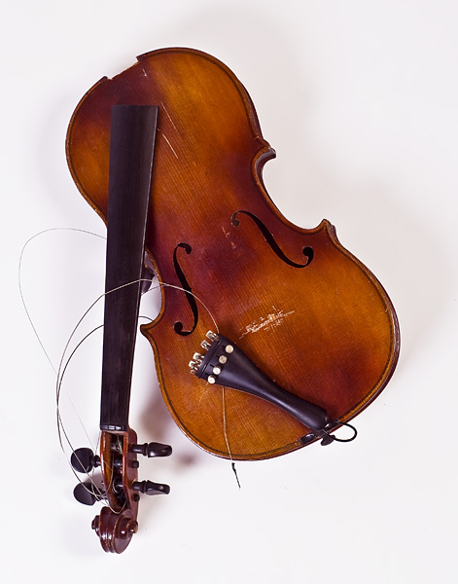
Thou Shalt Never Throw Your Instrument or use it as a weapon

Slide 11
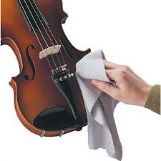
Thou Shalt Clean your Instrument
You must wipe rosin dust off of instrument and strings to protect the wood and varnish.

Slide 12
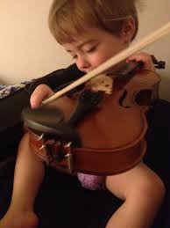
Thou Shalt Never Allow Others
to Play Your Instrument
You are responsible for damages and repairs.

Slide 13
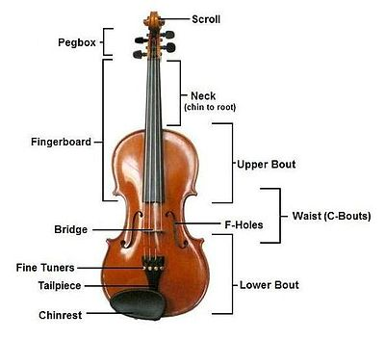
Thou Shalt Know the Parts of your Instrument

Slide 14
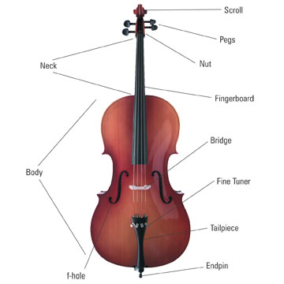
Thou Shalt Know the Parts of your Instrument

Slide 15
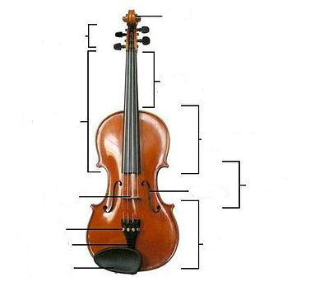
Instrument Parts Quiz - violin/viola
1.
2.
3.
4.
5.
8.
6.
7.
9.
10.
12.
11.

Slide 16
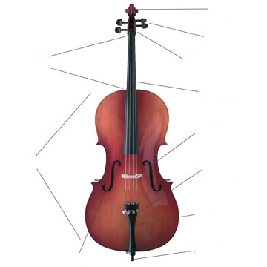
Instrument Parts Quiz - cello/bass
1.
2.
4.
3.
5.
6.
8.
7.
9.
10.
11.
12.

